Slide 1

Car Price Prediction Project
Abhishek Pai

Slide 2
Problem Statement
With the covid 19 impact in the market, A lot of changes are seen in the car market. Now some cars are in demand hence making them costly and some are not in demand hence cheaper. client works with small traders, who sell used cars. With the change in market due to covid 19 impact, client is facing problems with their previous car price valuation machine learning models. So, they are looking for new machine learning models from new data.

Slide 3
Business Goal
To make a machine learning models from new data to do valuate car price.

Slide 4
Steps
Extracting data from websites
Loading data set
EDA
Data cleaning
Encoding
Model building
Performing prediction
Saving best model

Slide 5
Data extraction (phase 1)
Data has been extracted for various sites
More than 5000 used cars data has been scraped for better model.
Columns uses are 'Brand', 'Model', 'Variant', 'Year', 'Fuel', 'Transmission', 'KM_driven', 'No_of_Owners', 'price'

Slide 6
Model building (phase 2)
1. Data Cleaning
2. Exploratory Data Analysis
3. Data Pre-processing
4. Model Building
5. Model Evaluation
6. Selecting the best mode

Slide 7
Data Cleaning and EDa
The data collected was not completely useable
The data was properly brought in format to make it usable
Once the data was usable pandas profiling was been used to perform EDA on the data set.

Slide 8
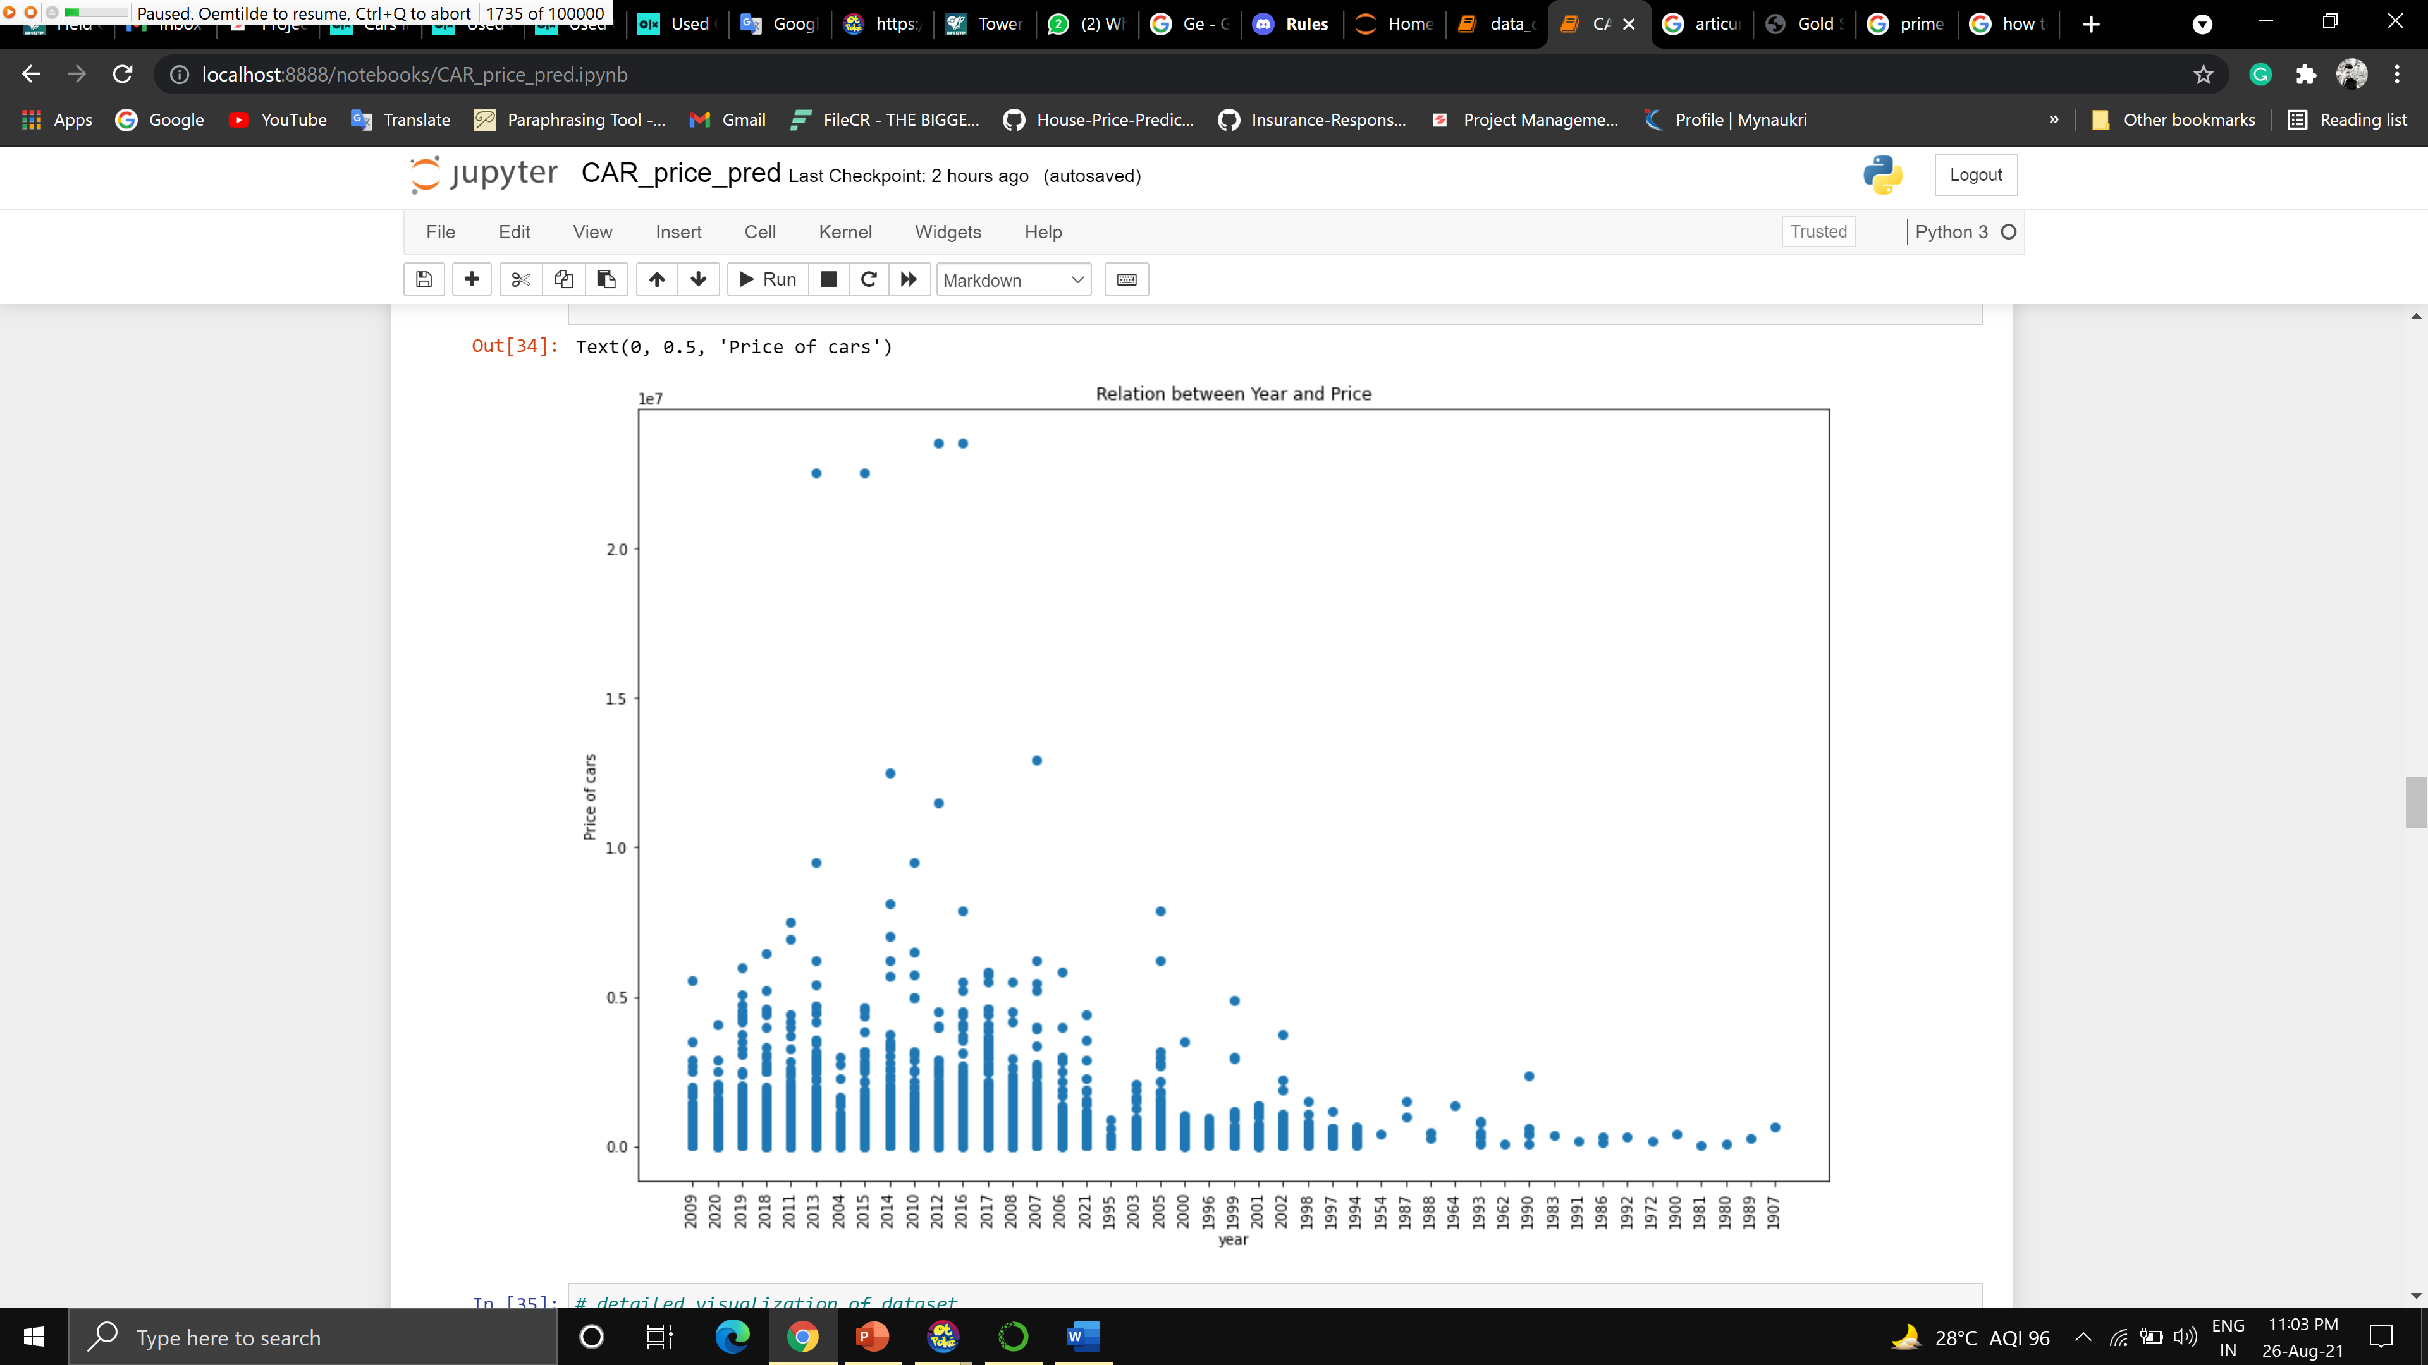
Relation between year and price of vehicles

Slide 9
Data Pre-processing and Model Building
Once the EDA was completed the data was encoded as it contained columns with object values
Once encoding scaling was done on dataset before model building
Following algorithms were been tried to get best result.
XGBRegressor | GradientBoostingRegressor
RandomForestRegressor | DecisionTreeRegressor
Ridge | LinearRegression
Lasso | ExtraTreesRegressor
AdaBoostRegressor | SVR

Slide 10
Model Evaluation and Selecting the best mode
After running different algorithms GBR that is Gradient Boost Regressor has performed better than others
After selecting best model i.e GBR, hyperparameter tuning was performed on it. The result turned to be bit less than that of untuned result.

Slide 11
Conclusion
As cross-validation score was considered for evaluating the models
The score for GBR before tuning was 0.6
After tuning the score was 0.48 which was been reduced.
Considering the score the best way to improve the result would be adding more data to dataset

